Slide 1


Training on Integrated progress report
Progress towards objectives, targets and contributions -
Greenhouse gas emissions and removals ANNEX I
Prepared by Ph.D. Marta Giulia Baldi
Presented by Per Wretlind and Aneliya Nikolova European Environment Agency
9 October 2025 | Sarajevo
Notes:
"A couple of points I want to draw attention to before we begin.“
1 Thank you so much for all the engagement, commitment, and feedback yesterday. I was impressed by your skills.“
2 I already start to work to identilfy M fields where you may not have data, and so reduce the level of error accordinlty.
3 said that, X-1 data…only in annex 17 table 2 and 5 the data requirimet it is not mandatory

Slide 2
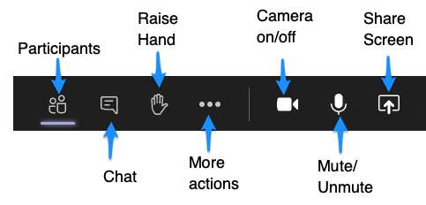
Welcome! How to participate online:
Please mute your microphone when joining the call.
Please indicate your intention to speak by raising your hand or sending a message in the chat, specifying your name and organisation.
Please only unmute your microphone when you are given the opportunity to speak.
Please remember to lower your hand after speaking, by clicking again on the hand symbol.
Please feel free to ask questions all along the meeting.
The meeting WILL be recorded

Slide 3
Agenda
Introduction & RP3 - EEA
Thematic aspects of reporting - NECPR Annex I - EEA
Q&A
Reportnet 3 - Annex I
Q&A
MS example (2023 data) & Export example
Q&A

Slide 4

National Energy and Climate Progress Reporting
Context
Notes:
Rodrigo PEREZ

Slide 5



The Adapted Governance Regulation: planning & reporting
National Energy and Climate Plans
(NECP)
2018/9 & 2023/4 (+10yr)
(………….+5 yr)
National Energy and Climate Progress Reports
(NECPR)
15 Mar. 2025 (+2yrs)
Adapted Governance Regulation 2018/1999: Article 3, 9, 14, 17

Slide 6
Dataflows in Reportnet 3: what are we focusing on today?
Many dataflows to be reported under the Governance Regulation 2018/1999 in Reportnet 3:
NECPR – Progress to targets (GHG)
NECPR – Progress to targets (RES)
NECPR – Progress to targets (EE)
NECPR – Adaptation (Article 17)
NECPR – Additional reporting (RES)
NECPR – Additional reporting (EE)
Integrated National Policies and Measures (PaMs)
National systems for reporting on PaMs and projections
National GHG projections
Adaptation planning and strategies (Article 19)
European Climate Law Recommendations (*)
* This dataflow is aligned with NECPR but is voluntarily provided under the European Climate Law

Slide 7
Reportnet 3
Logging in & set-up

Slide 8

Dataflow: Logging into Reportnet

Slide 9
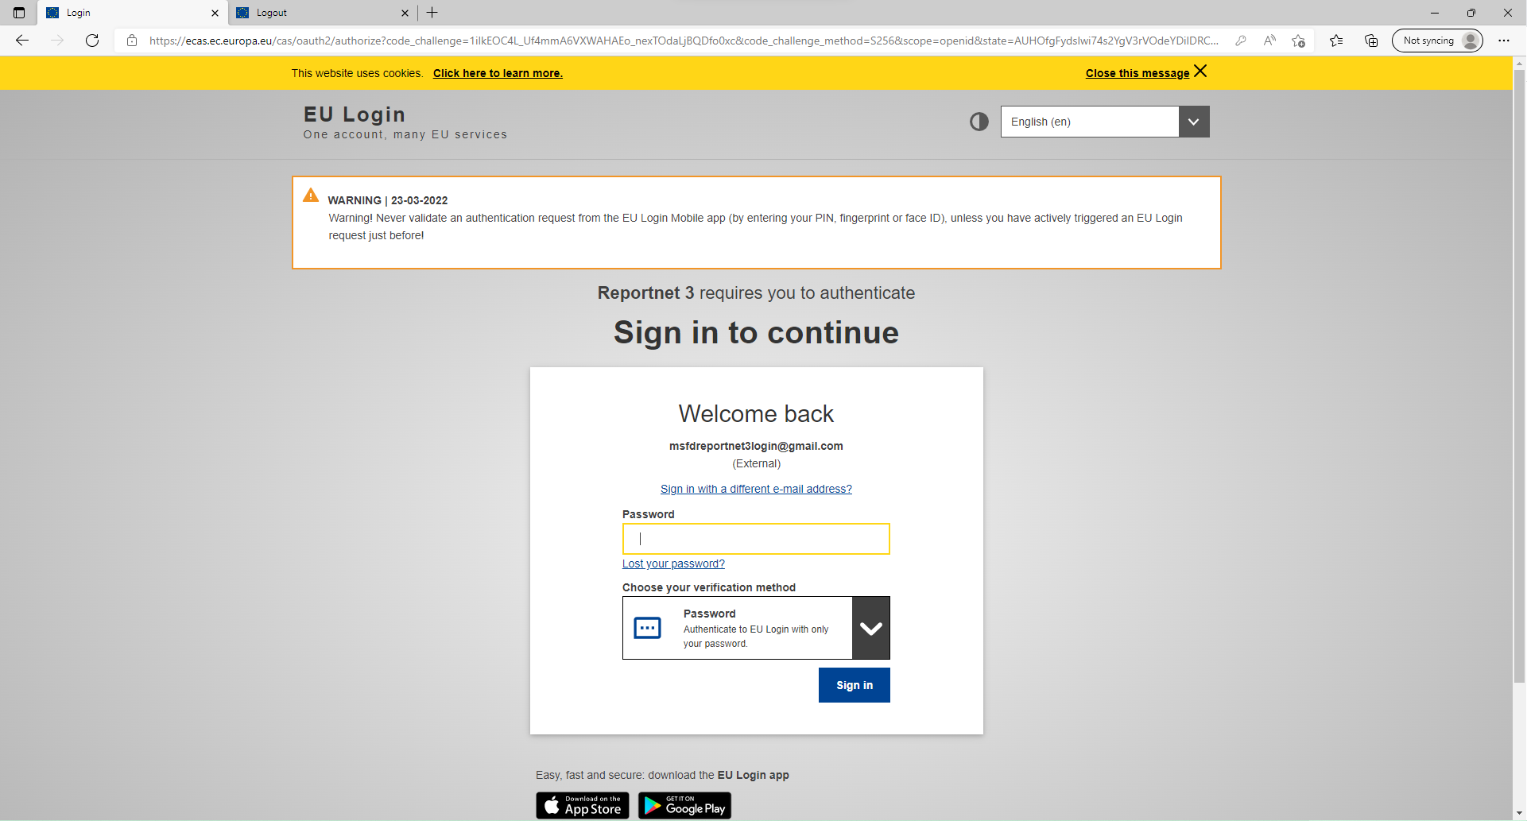

PaMs: Logging into Reportnet
Guidance on getting EU login and registering on the platform can be found in this document.
Multi-factor authentication (MFA) now required to access Reportnet 3. Guidance to set this up in this document.

Slide 10
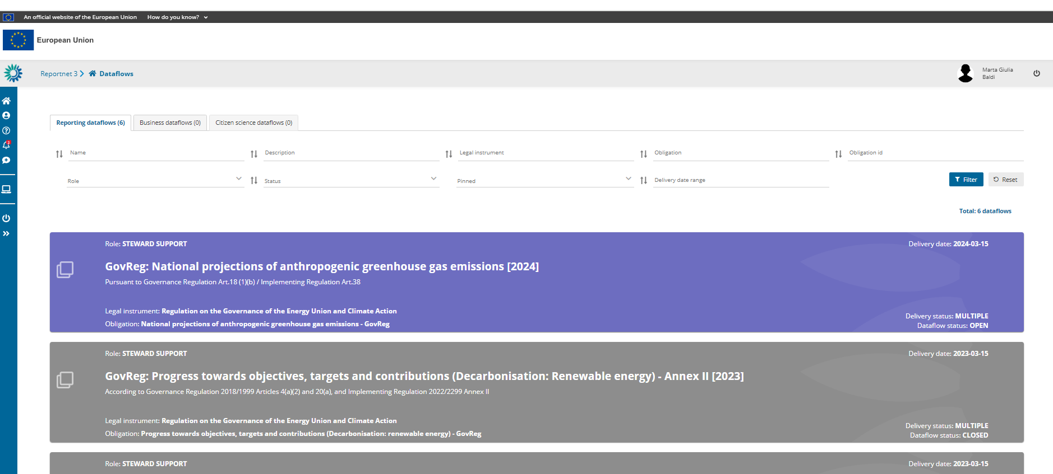
Dataflow: Logging into Reportnet
Open dataflow: Purple
Closed dataflow: Grey

Slide 11
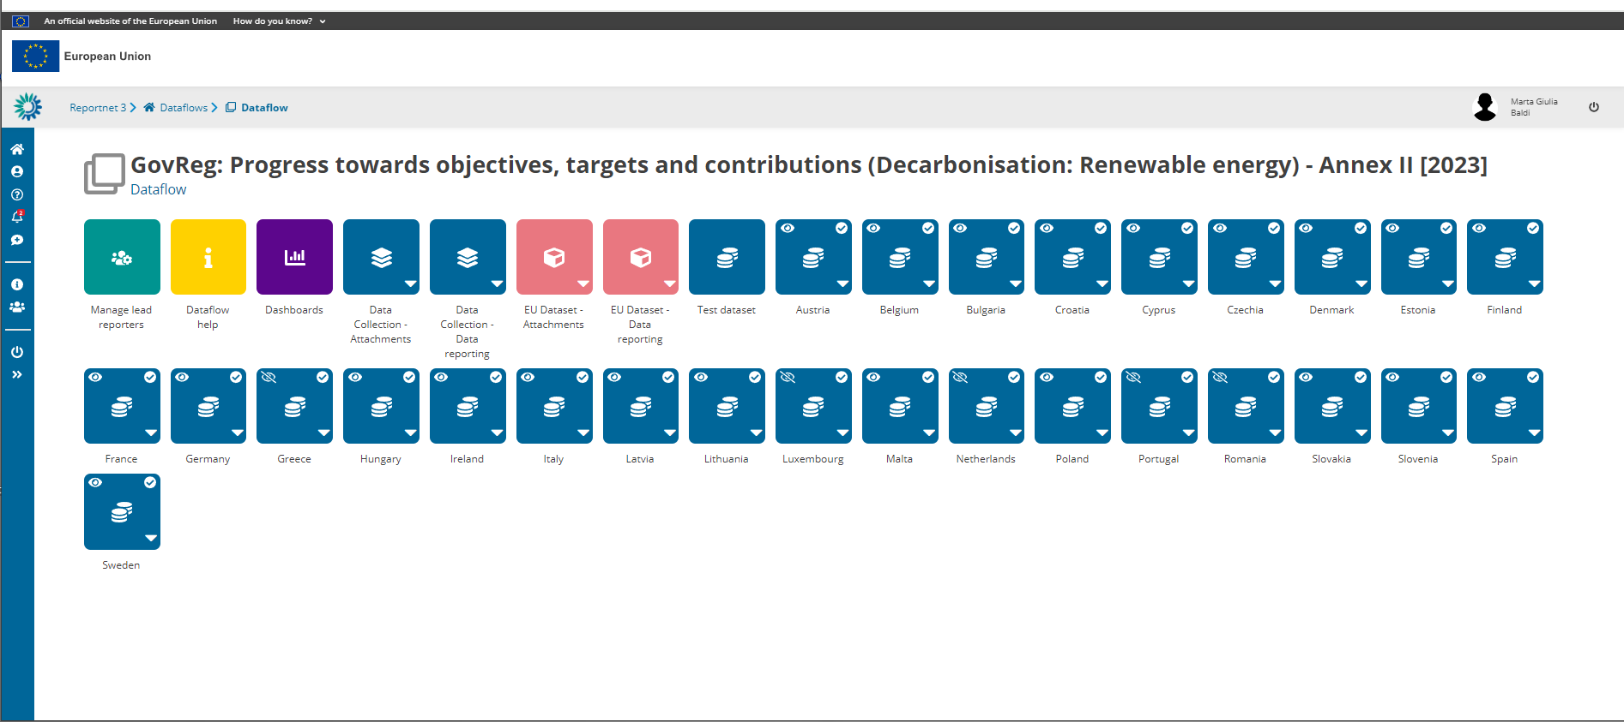
Dataflow: Dataflow help

Slide 12
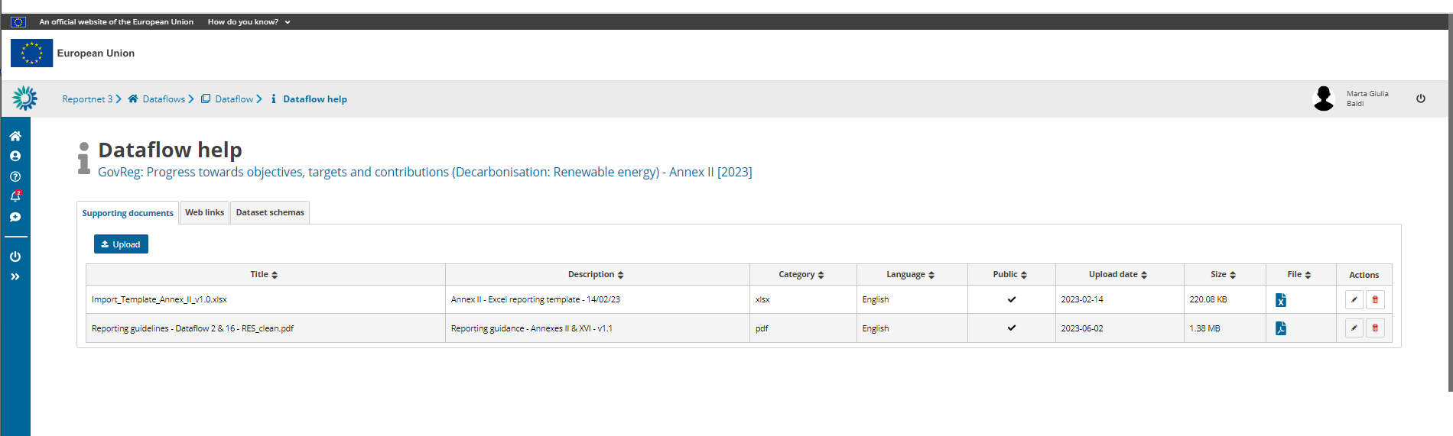
Dataflow: Dataflow help
Reporting guidance documentation
Import templates
Useful weblinks
Download link(s) here

Slide 13
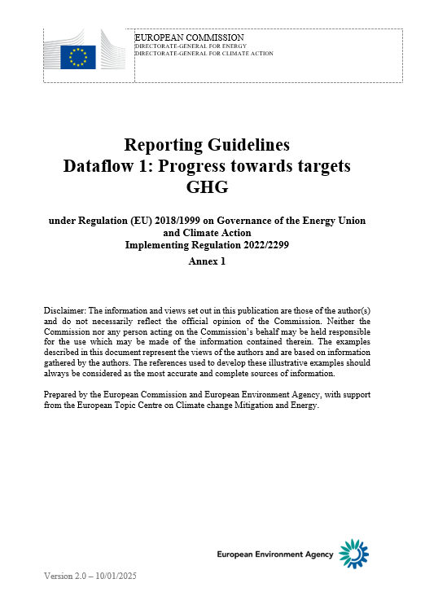
NECPR Annex I – Decarbonisation
Reporting Guidelines
Structure
Introduction
Reportnet3
Technical details of reporting
Thematic guidelines:
Reporting tables
Fields by tables
Finalising the reporting
QAQC control
Annexes

Slide 14
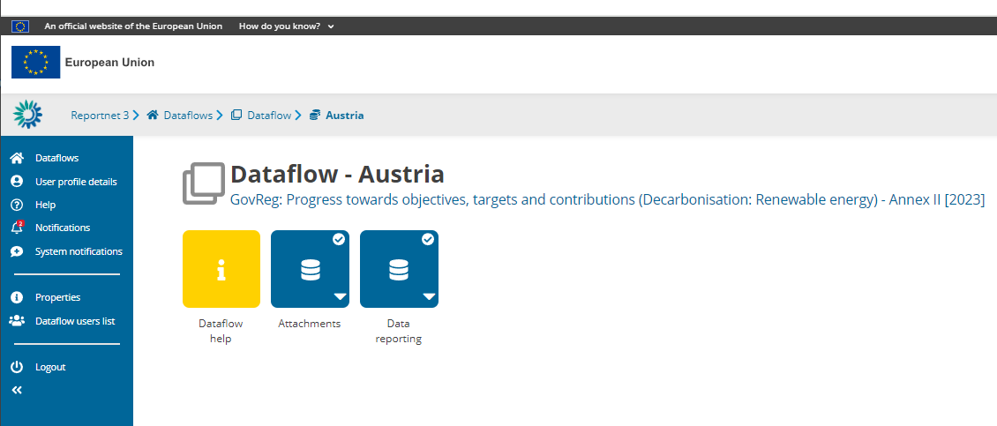
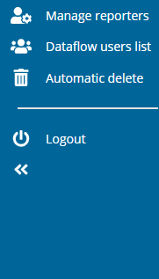
Dataflow: Manage Reporters
Manage reporters (as lead reporter):
Add additional reporters to access dataflow
Reporters cannot release to data collection
Dataflow user list:
View who is selected as reporters

Slide 15



Roles in Reportnet 3
Lead reporter(s)
Up to two per CP per dataflow
Formally nominated
Able to submit final data.
Supporting reporter(s)
Unlimited number per CP per dataflow
Managed by lead reporter(s)

Slide 16

Reportnet 3
Data input - overview

Slide 17
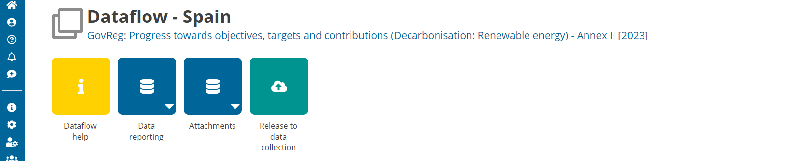




Overview of dataflow page
1.
2.
3.
4.
1. Navigation bar
Reporter management
Notifications!
2. Dataflow help
Documentation
Guidance
Legislation
3. Reporting schema
Where to report data
Focus on data reporting
Attachments to supplement reporting
4. Release data
The button to officially submit data

Slide 18




Where can I access “prefilled” data?
Prefilling / Post-filling is data that is not reported within this dataflow in Reportnet.
Reported data
To be filled in by CPs in Reportnet 3
Prefilled data
Information provided by CPs prior to 15 March in other means (i.e. Eurostat)
Post-filled
Information being provided by CPs simultaneously to 15 March in other dataflow(s) (i.e. Eurostat)
Calculations
Calculations based on reported values
Prefilled data can be downloaded & reviewed via excel exports in Reportnet 3
If issue of prefilled data: contact data provider!!

Slide 19
Overview of prefilled / post-filled data in this dataflow
Annex I
Reported values
Table 1
Table 2
Table 3
Table 4
Prefilled
Post-filled
GHG Inventory
GHG Projections
AEAs
GHG inventory
GHG Projections
GHG inventory
GHG Projections
Calculated
Notes:
(2) Annual emission allocation pursuant to Article 4(3) of Regulation (EU) 2018/842 of the European Parliament and of the Council of 30 May 2018 on binding annual greenhouse gas emission reductions by Member States from 2021 to 2030 contributing to climate action to meet commitments under the Paris Agreement and amending Regulation (EU) No 525/2013 (OJ L 156, 19.6.2018, p. 26), adjusted in accordance with Article 10 of that Regulation, or any subsequent annual GHG emissions targets in this regard.

Slide 20
New to 2025: Notation keys
What is a Notation Key?
A system to clarify lack of numerical data (where unavailable or not applicable).
Required for mandatory if applicable (Miap), if available (Miav), or voluntary (V) reporting.
Notation key | Description
NA | Not applicable - For data and activities in a reporting country that are not applicable or relevant to the context of the reporting country. Anticipated to be used in the context of Miap and V reporting fields. This notation key can be used instead of a value or 0, to ensure complete reporting.
NAv | Not available – For data and activities in a reporting country that are applicable to the context of the reporting country, however the data is not available. Anticipated to be used in the context of Miap, Miav and V reporting fields. This value can be used instead of a value or 0, to ensure complete reporting.
C | Confidential – Specifically for Annex II, Table 5, reporting on greenhouse gas savings performance of biofuels. This notation key is for data and activities in a reporting country that are available but are confidential and therefore cannot be reported publicly at a disaggregated level.
Import templates provide overview of when notation keys are accepted
For any issues check the reporting guidelines!
GHG (Annex I)
RES (Annexes II & XVI)
EE (Annexes IV & XVII)
Applicable to these dataflows

Slide 21

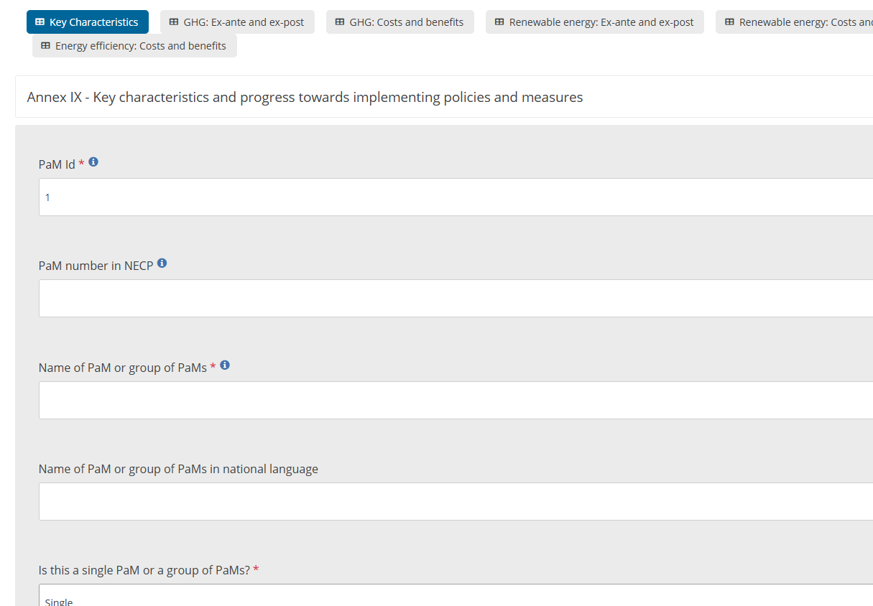
Reportnet: Webform
Webform
Simplified data entry in system – Is an easier way to directly input data without complex IT interface (tabular data).
Data formats assured – reporting via the webform only allows the correct values to be input (text, numbers, lists), ensuring a reduced quality check process required.
Direct QC review – quality checks are directly visible in the webform in a more user-friendly mode, to help with updating such issues.

Slide 22

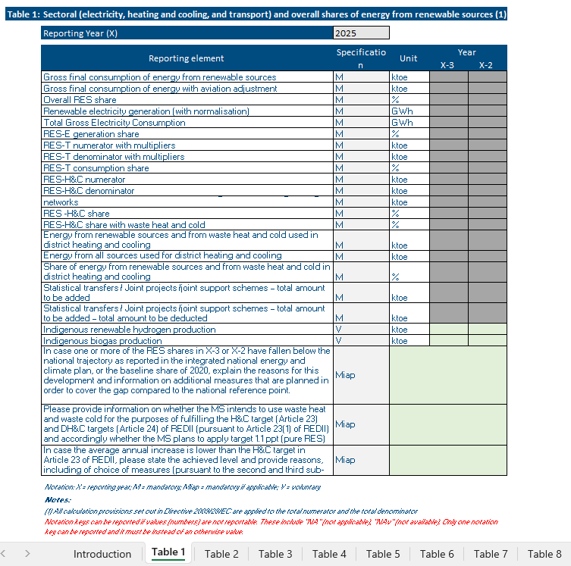
Reportnet: Excel import / Reportnet 3 tabular editing
Excel import
Easy to use - Excel follows structure of legislation.
Prefilling/Post-filling overview - Highlights where data should be reported (green cells) and where no reporting in Reportnet 3 is required (grey cells – prefilled / post-filled).
Risk – If import not used correctly can cause issues on the finally imported data to Reportnet 3.
Do not edit data formats / structures – be careful when copying and pasting!
Excel import does not equal reporting – reporting is only considered complete once an official submission in the platform is made. Therefore, once data is imported, quality checks and final check of data is required!

Slide 23
Specifications & colors
M – Mandatory
Miap – Mandatory if applicable
Miav – Mandatory if available
V – Voluntary
Green – NECPR reporting exercise,
Yellow – Prefilled data
Orange – Postfilled data
Blue – Calculated cell which utilises other data in table.
Notes:
these are all very subjective to the reporting obligation and field you talk about:
M – Mandatory – Required to report to fulfil reporting obligation.
Miap – Mandatory if applicable – Required to report to fulfil reporting obligation if the activity of reporting is happening in the reporting entity.
Miav – Mandatory if available – Required to report to fulfil reporting obligation if the data is avaialble for reporting.
V – Voluntary – Not required to report, however can provide further details on the reporting information if applicable and avaialble by the reporting entity.

Slide 24


Reportnet 3
Data input – excel import

Slide 25
Reportnet: Excel import / Reportnet 3 tabular editing
Excel import
Easy to use - Excel follows structure of legislation.
Prefilling/Post-filling overview - Highlights where data should be reported (green cells) and where no reporting in Reportnet 3 is required (grey cells – prefilled / post-filled).
Risk – If import not used correctly can cause issues on the finally imported data to Reportnet 3.
Do not edit data formats / structures – be careful when copying and pasting!
Excel import does not equal reporting – reporting is only considered complete once an official submission in the platform is made. Therefore, once data is imported, quality checks and final check of data is required!

Slide 26
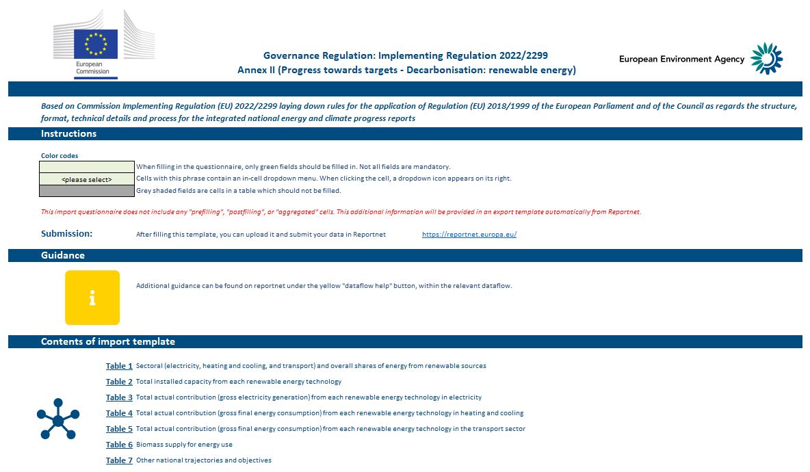
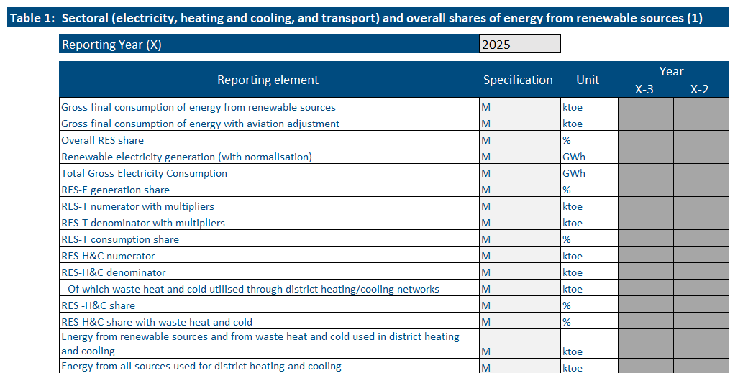
Using the excel import
Excel import templates are split into two parts:
Introduction
Provides information on the import template
Legal reporting tables
Copies legislation format: green = MS input!
! Do not edit formatting or structure of template !
It can result in incorrect imports or importing values which will result in blockers.
It is the Member States’ responsibly to ensure the data is imported correctly to Reportnet 3.

Slide 27
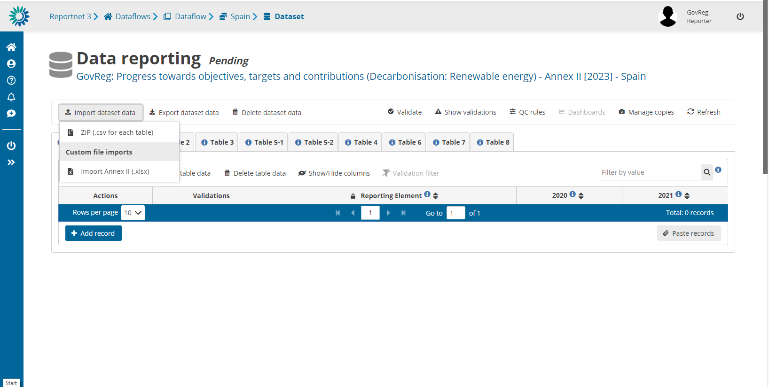
Imports – where to select import

Slide 28
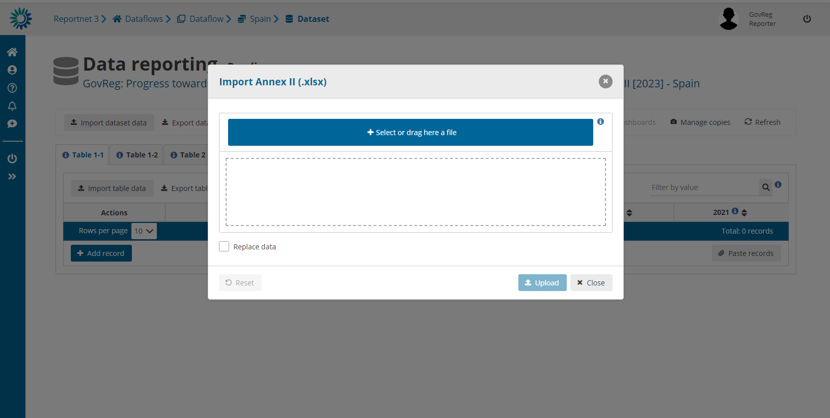
Imports – select the import file and upload!

Slide 29



Imports – check final data in Reportnet!
Review that data was imported correctly
Validate data in system to ensure format and data is to quality standards

Slide 30
Reportnet 3
Data input – excel export

Slide 31
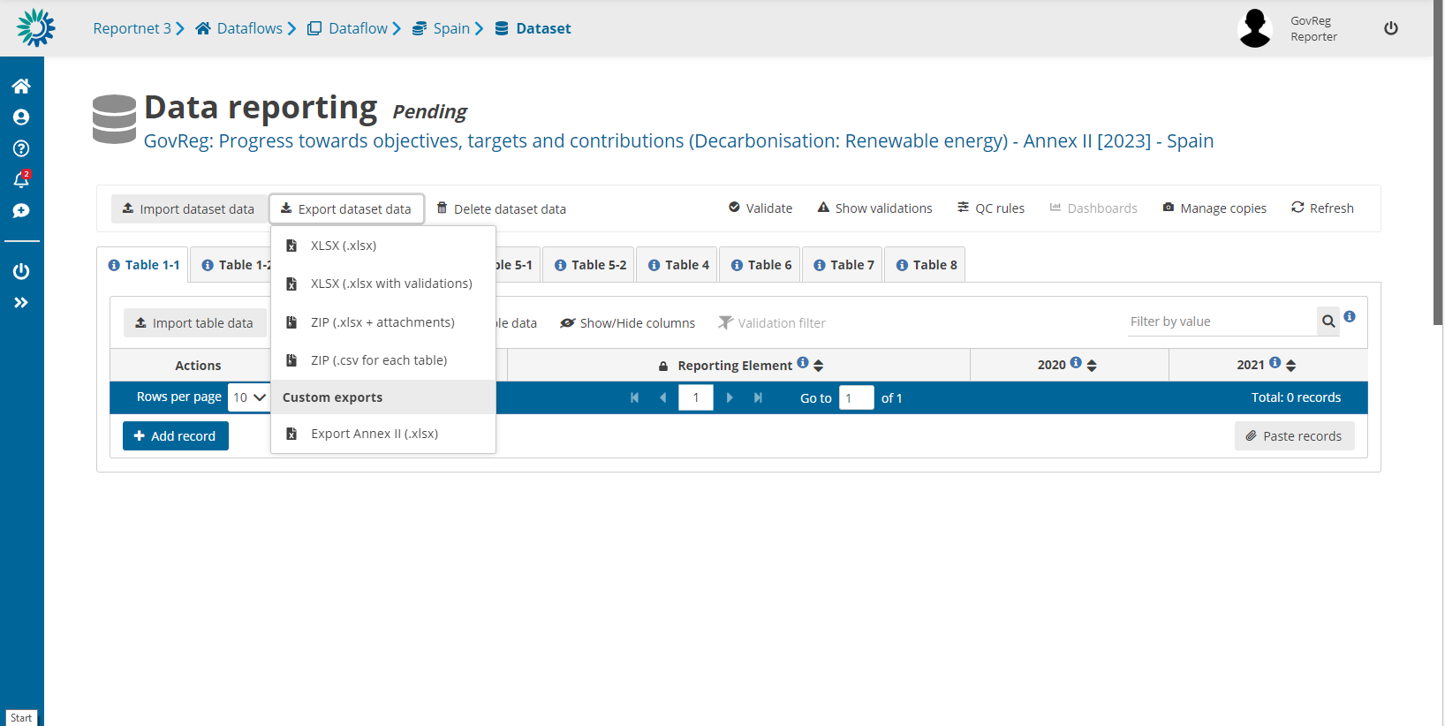
Exports – where to download the file

Slide 32
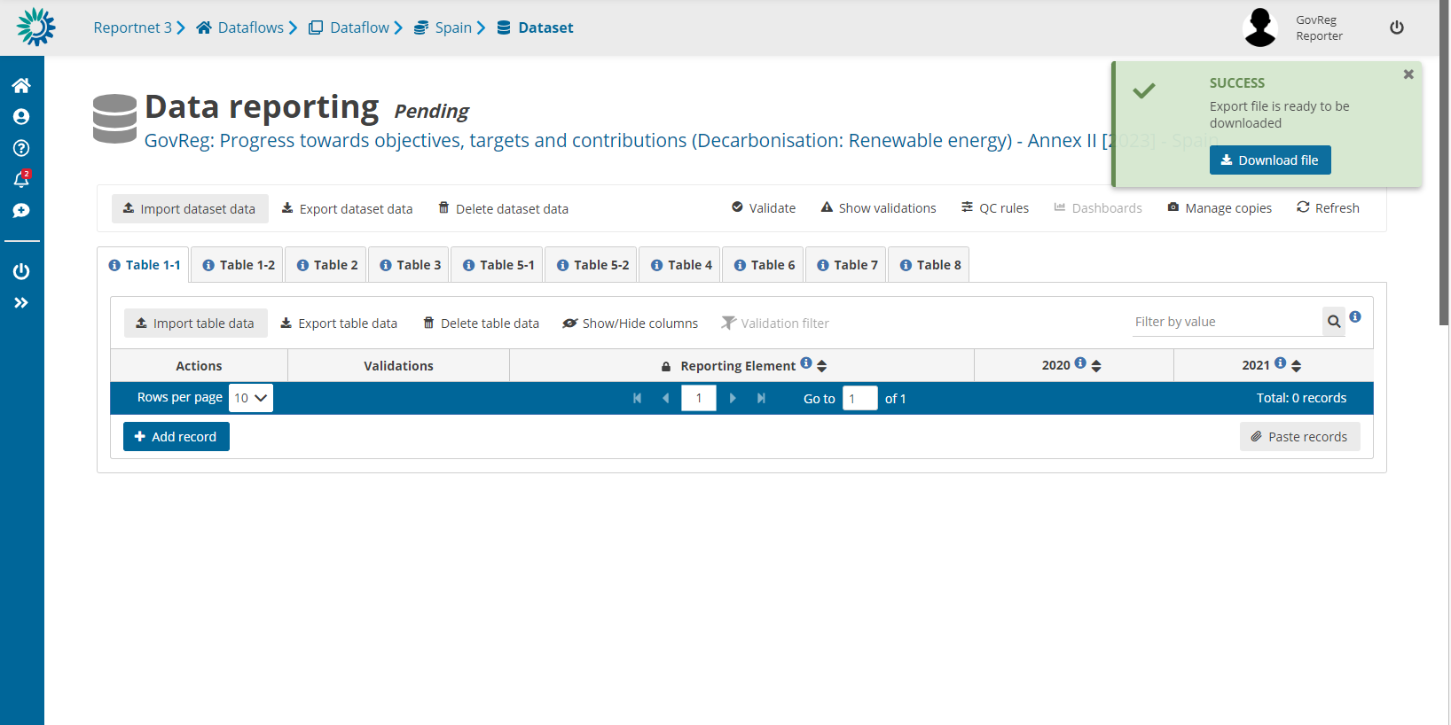
Exports – download takes a few moments

Slide 33
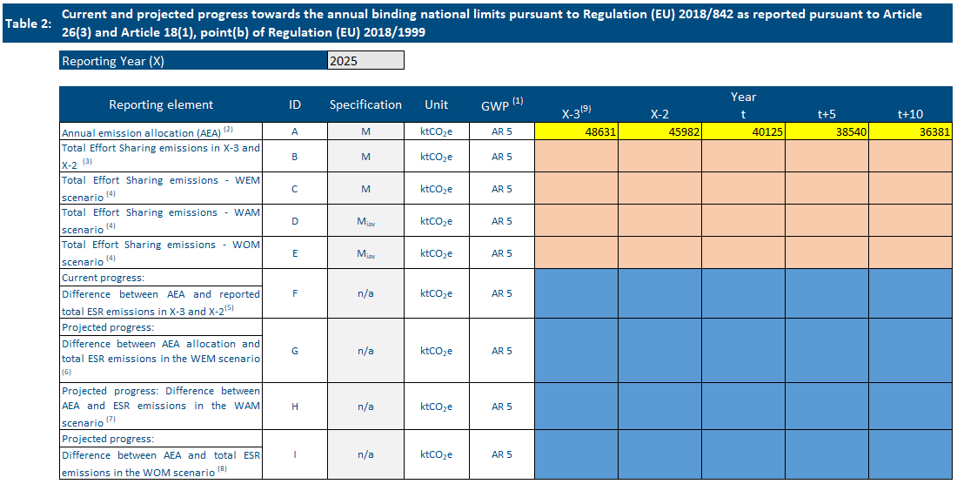
Purpose of exports – Annex I
Purpose of exports:
To export reported values (green cells)
To review prefilled (Eurostat data) (yellow cells)
Export templates can be used again as an import template.
Prefilled data in Annex I refers to Allocated Emission Allowance data in Table 2. This table does not require active reporting (green cells).
Dataflows with prefilling:
GHG (AnnexI)
RES (Annexes II & XVI)
EE (Annex IV)

Slide 34

Reportnet 3
Quality assurance - validations

Slide 35
Specifications & colors
M – Mandatory
Miap – Mandatory if applicable
Miav – Mandatory if available
V – Voluntary
Green – NECPR reporting exercise,
Yellow – Prefilled data
Orange – Postfilled data
Blue – Calculated cell which utilises other data in table.
Notes:
these are all very subjective to the reporting obligation and field you talk about:
M – Mandatory – Required to report to fulfil reporting obligation.
Miap – Mandatory if applicable – Required to report to fulfil reporting obligation if the activity of reporting is happening in the reporting entity.
Miav – Mandatory if available – Required to report to fulfil reporting obligation if the data is avaialble for reporting.
V – Voluntary – Not required to report, however can provide further details on the reporting information if applicable and avaialble by the reporting entity.

Slide 36



Validations – types of errors
Warning (can release data)
Error (can release data)
Blocker (can’t release data)

Slide 37
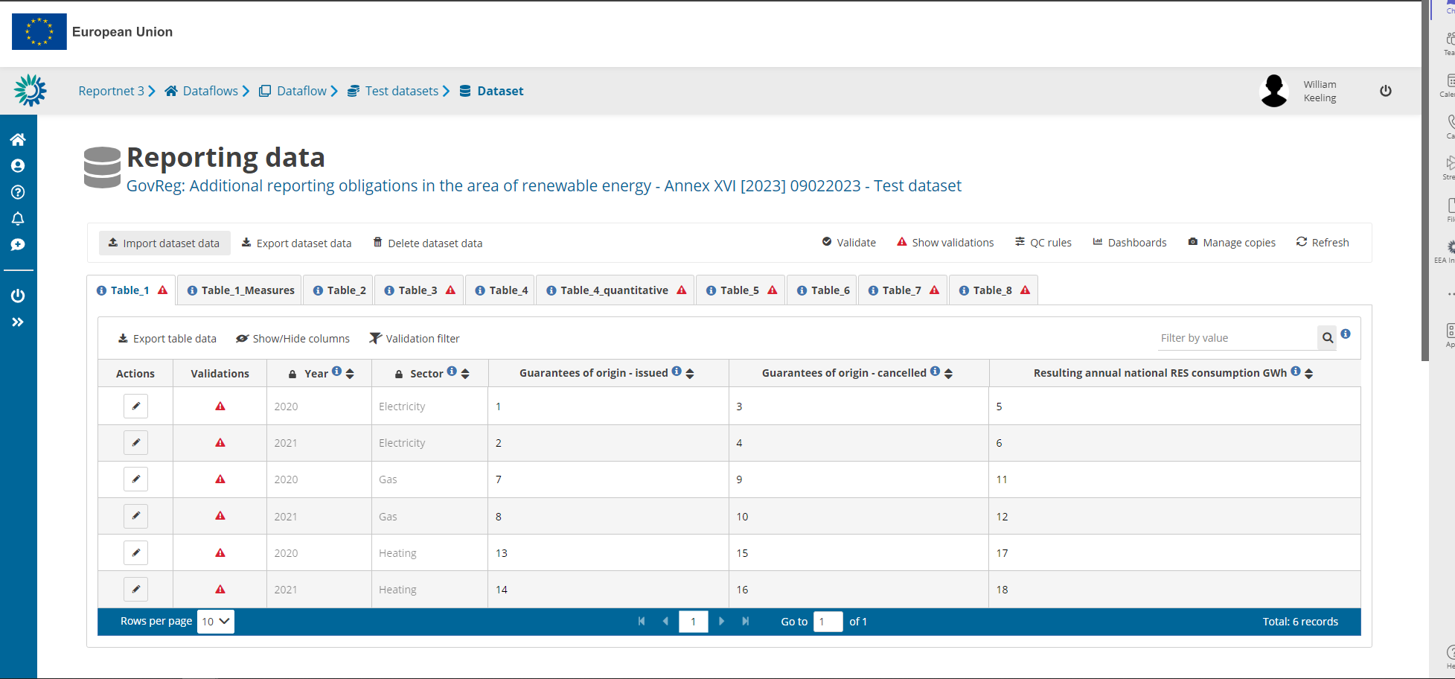
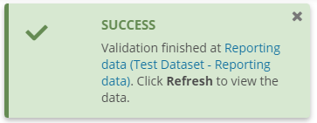
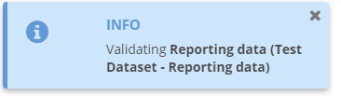
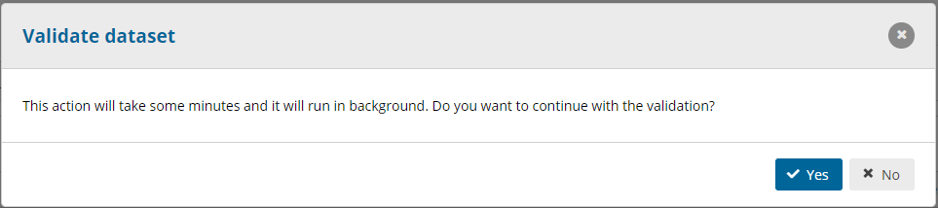
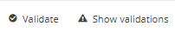

Validations – how to run the automated quality checks
Add any number of slides for print screens for this Section
`

Slide 38
Validations – reviewing errors in the dataflow
Add any number of slides for print screens for this Section
1. Table level errors
2. Record level errors
3. Specific errors

Slide 39
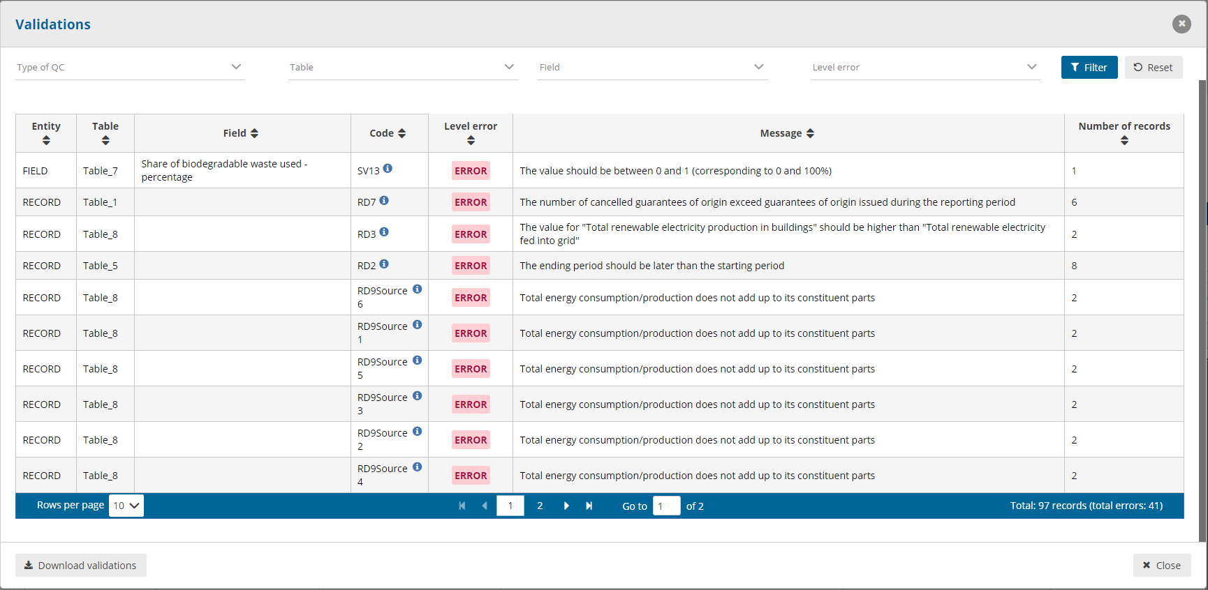
Validations – overview of errors in dataset
Filtering options available here
To view all validations in dataflow
Download validations in a csv. here

Slide 40
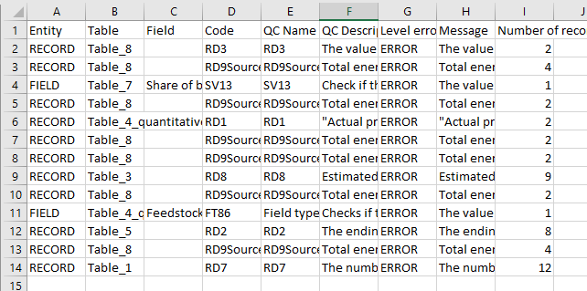
Validations – overview of errors in dataset
Filtering options available here
To view all validations in dataflow
Download validations in a csv. here

Slide 41

Validation
Blocking errors require a change of the reporting data. Release cannot be performed.
Two ways to correct or update data:
Correct the Excel template and re-import the updated template
When re-importing a modified template, always click on “Replace data” before importing and validating an updated template
✓ Correct the fields directly in Reportnet by clicking on the field.
In any case, the data must be validated → “Validate” and “Refresh”.
Notes:
Rodrigo PEREZ

Slide 42

Reportnet 3
Release of data - submission

Slide 43
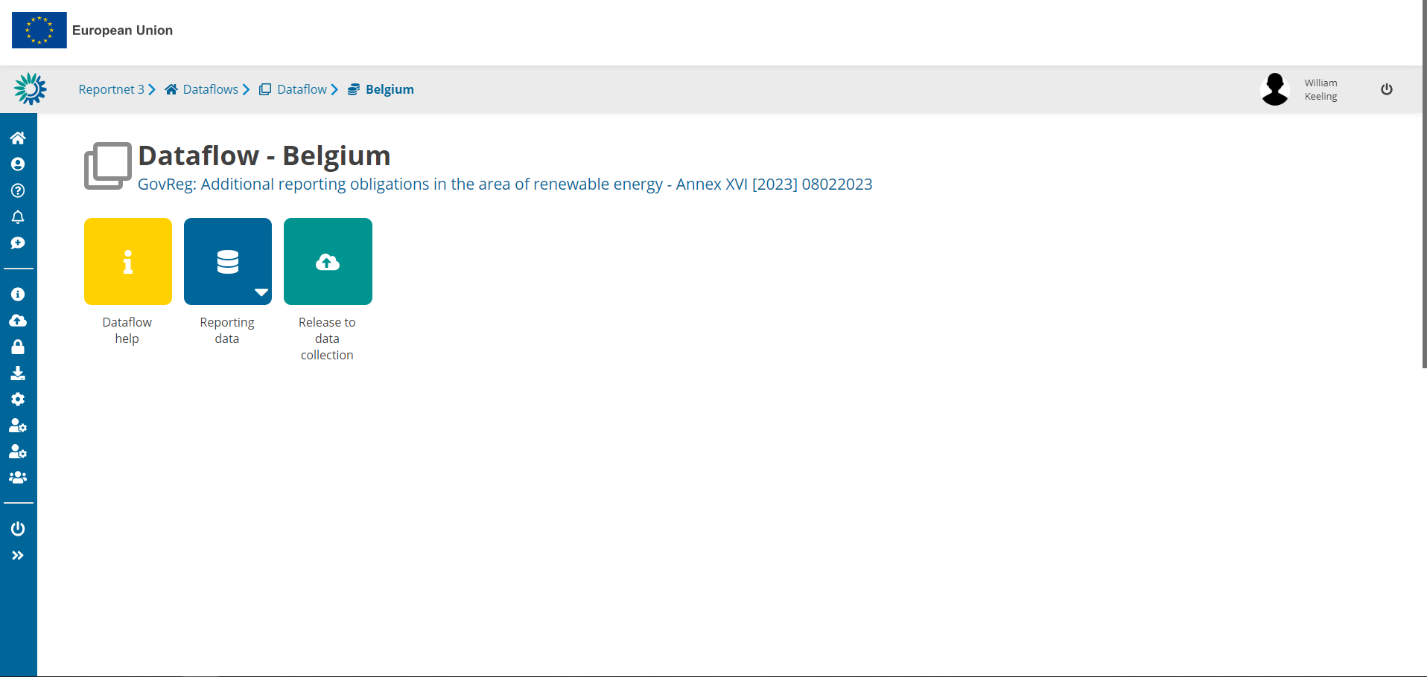
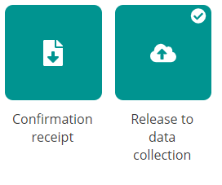
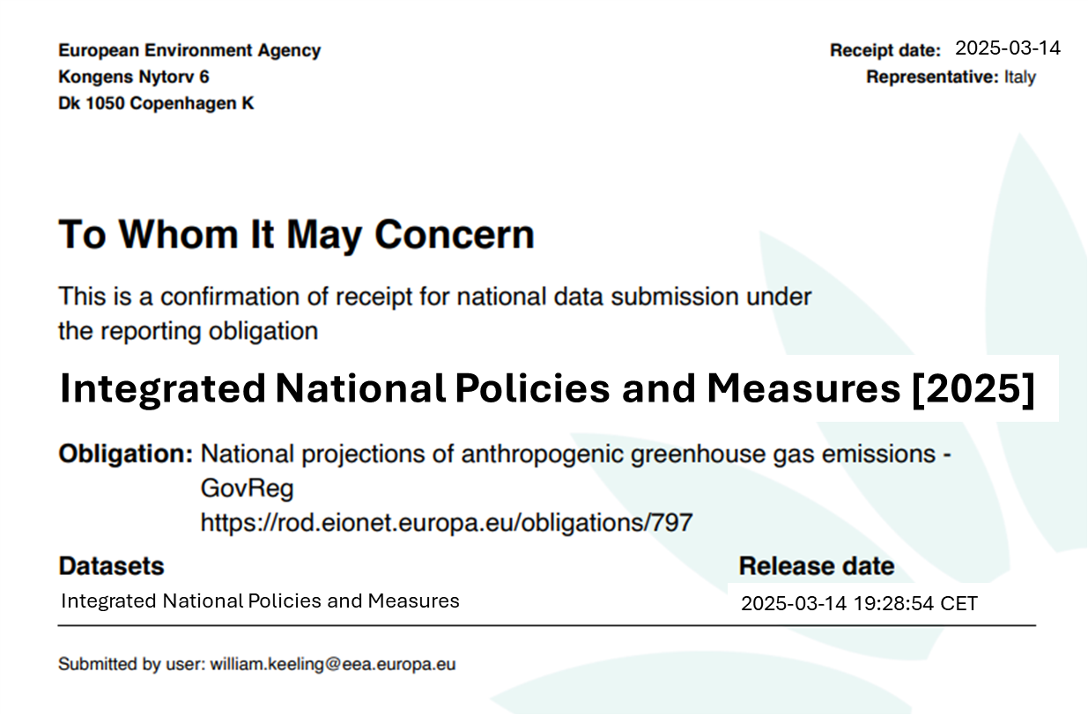
Data submission
Add any number of slides for print screens for this Section
Releasing data can take a while
This can run in the background while you do other tasks!
! If the confirmation receipt does not appear a blocker remains in your dataflow and must be resolved before releasing again !

Slide 44

Annex I – Decarbonisation
Thematic guidance
Notes:
NECPR – Progress to targets (GHG)

Slide 45
PROGRESS TO TARGET – GHG Emission and Removals
Article 4 (a)(1) – Progress towards objectives, targets and contributions (Greenhouse gas emissions and removals)
By 15 March 2025 and every second year thereafter, CPs shall report to the Energy Community Secretariat: (1) information on the progress accomplished towards reaching the objectives, targets and contributions set out in the adopted integrated national energy and climate plan; (2) National Long-term strategies, including National target for net Greenhouse Gas Emissions compared to 1990 levels; (3) Descriptive and quantitative information on progress toward individual national LULUCF commitments; (4) Additional national/sectoral target and projected progress under “With Existing Measures” (WAM)“ and/ or With Additional Measures” (WEM) scenarios.
Reports due: | 15 March – Biannually – To start in 2025
Notes:
The approach I’ve taken so far in this presentation is to outline what is reported, rather than what needs to be reported (according to legislation).

Slide 46
PROGRESS TO TARGET – GHG Emission and Removals - Tables
Table 1 – Current and projected national progress towards the national greenhouse gas (GHG) emissions reduction targets in view of climate-neutrality,
Table 2 – Current and projected progress towards the annual binding national limits pursuant to Regulation (EU) 2018/842,
Table 3 - Current and projected progress towards commitments pursuant to Regulation (EU) 2018/841,
Table 4 - Current and projected progress towards other national greenhouse-gas related targets and objectives set out in integrated national energy and climate plans, including sector targets.
Notes:
Annual Emission Allocation data - it is data prepared by our ETC for a task we undertook for the Commission to monitor effort sharing emission allocations per MS.
Again ESR doesn't exist for Energy Community, so less sure how relevant it is for them. But I can't remember what is in table 2 of Annex I for Energy Community - I seem to remember there is some info that is not necessary or relevant for CPs.

Slide 47
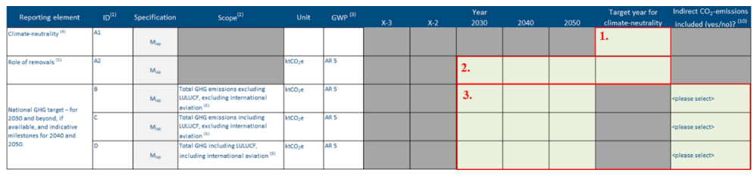
Annex 1 – Table 1
Current and projected national progress towards the national greenhouse gas (GHG) emissions reduction targets in view of climate-neutrality (Mandatory, if applicable)
Climate-neutrality
Role of removals
National GHG target for 2030 and beyond, and indicative milestones for 2040 and 2050
number (integer)
Negative number (decimal)
FIELD 1: The purpose of this field is to confirm, if national climate-neutrality objective is in place, the targeted year for climate-neutrality, in line with their long-term strategies.
FIELD 2: In view of achieving the objective of climate neutrality, the potential to capture and remove carbon dioxide from the atmosphere is crucial. The purpose of this field is to have a clear understanding of the role played by the natural sinks (e.g. LULUCF, including harvested wood products) and technical sinks
e.g. Carbon Capture and Storage (CCS) and Carbon Capture and Utilization (CCU), in the achievement of the given target.
Notes:
Direct emission from controlled sources , Indirect emission scope 2: electricity generation or the electricity used, indirect emission scope 3 from value chain .
If national total GHG emissions target for 2030, 2040 or 2050 is in place, and/or climate-neutrality objective, CPs should add the total estimated removals for the target year respectively in ktCO2e. In the context of carbon removal certification framework, ‘carbon removal’ means either the storage of atmospheric or biogenic carbon within geological carbon pools, biogenic carbon pools, long-lasting products and materials, and the marine environment, or the reduction of carbon release from a biogenic carbon pool to the atmosphere.
3 kinds of removals are distinguished: • permanent carbon storage (geological removals); • carbon storage products (ie product-based removals); and, • carbon farming (i.e. land-based removals).

Slide 48
Annex 1 – Table 1
Current and projected national progress towards the national greenhouse gas (GHG) emissions reduction targets in view of climate-neutrality (Mandatory, if applicable)
Climate-neutrality
Role of removals
National GHG target for 2030 and beyond, and indicative milestones for 2040 and 2050
number (decimal)
Text
Yes or no
FIELD 3: The purpose of this field is to indicate, confirm, national economy-wide GHG emissions targets for 2030 and beyond, consistent with the Paris Agreement and the current NECP.
They have to provide quantified levels of total GHG emissions to be achieved in 2030, 2040 and 2050, in ktCO2e.
Where available, they have to provide the total levels of GHG Emissions without LULUCF and international aviation, including LULUCF and excluding international aviation, and including both LULUCF and international aviation.
Notes:
Direct emission from controlled sources Indirect emission scope 2: electricity generation or the electricity used, indirect emission scope 3 from value chain .
…, and in line with its long-term strategy reported under Article 15 of Regulation (EU) 2018/1999.

Slide 49
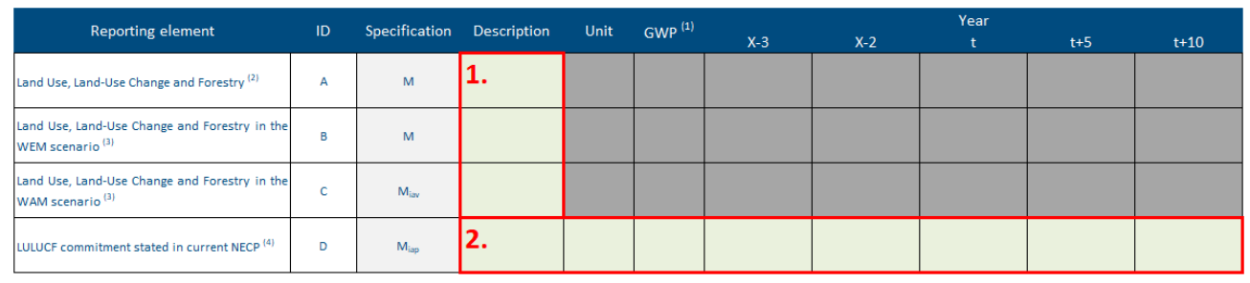
Annex 1 – Table 3
Current and projected progress towards commitments pursuant to Regulation (EU) 2018/841 of the European Parliament and of the Council as reported pursuant to Article 26(3) and Article 18(1), point (b) of Regulation (EU) 2018/1999 (Mandatory and Mandatory, if applicable)
LULUCF
LULUCF in WEM
LULUCF in WAM
LULUCF commitment in NECP
ktCO2e
FIELD 1: Description for pre-filled LULUCF emissions data, possibly by using links and references to existing documents, on the following:
• For historical data: detailed figures by LULUCF categories, explanations of the main natural and policy drivers of LULUCF emissions and removals, description of the inventory methodologies, envisaged enhancements to the inventory methodologies;
• For projected data (WEM-WAM): detailed figures by LULUCF categories, estimation of the gap between WEM/WAM and the ambition level necessary to reach LULUCF commitment, quantitative estimates of the mitigation impact of the LULUCF relevant policies and measures (including under the Common Agriculture Policy), consistency with the long-term strategy, description of the projection methodologies, envisaged enhancements to the projection methodologies.
Notes:
Information according to which Global Warming Potential values the GHG emissions shall be reported. GHG inventory data
GWP AR 5 = Global Warming Potential values from the IPCC’s 5th Assessment Report.
'with additional measures' (WAM)
'with existing measures’ (WEM)

Slide 50
Annex 1 – Table 3
Current and projected progress towards commitments pursuant to Regulation (EU) 2018/841 of the European Parliament and of the Council as reported pursuant to Article 26(3) and Article 18(1), point (b) of Regulation (EU) 2018/1999 (Mandatory and Mandatory, if applicable)
LULUCF
LULUCF in WEM
LULUCF in WAM
LULUCF commitment in NECP
FIELD 2:
Data format: text for description, unit and GWP. Number (decimal) for years (X-3, X-2, t, t+5, t+10).
Negative values indicate the LULUCF sector is a sink of net removals for the reported year.
Positive values indicate the LULUCF sector is a source of net emissions from the reported year.
Notes:
The years are defined as follows:
– t = the first future year ending with 0 or 5 immediately following the reporting year; therefore, the years for reporting as mentioned in the template will be t, t+5 and t+10. For instance – 2025, 2030 and 2035
– X = reporting year; therefore, the years for reporting as mentioned in the template will be X-3 and X-2, for instance the historic reporting years for a submission in 2025 will be 2023 and 2022. Please note that X-3 will be voluntary for those CPs submitting their first progress updates in 2023.

Slide 51
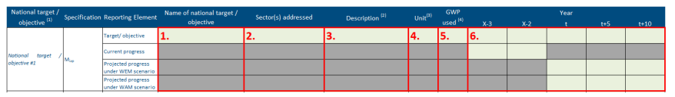
Annex 1 – Table 4
Current and projected progress towards other national greenhouse-gas related targets and objectives set out in integrated national energy and climate plans, including sector targets in accordance with Article 4(a), point (1)(iii) of Regulation (EU) 2018/1999 ( Mandatory, if applicable)
text
FIELD 1: The purpose of this field is to provide the name of the national target or objective.
FIELD 2: The purpose of this field is to describe the scope and potential of impact of the target. It is necessary to understand the sector(s) that the CPs targets.
FIELD 3: : The purpose of this field is to provide a textual description of the target/objective and, if needed, a qualitative assessment of the progress to target. (e.g. to reduce GHG emissions in this sector by 15 % in 2030 (compared to 2005)
FIELD 4 : The purpose of this field is to add units comparable to the unit of projected progress data.
FIELD 5 : The purpose of this field is to describe the Global Warming Potential references used. (AR 4 or 5 = Global Warming Potential values from the IPCC’s 4th or 5thAssessment Report )
Notes:
The purpose of this table is for the CPs to ensure a comprehensive, robust and comparable report of all other national targets and objectives set by the CPs in their current NECPs.
These are on top of the those required under EU regulation. Those other national target and objectives should be in line with the objective of the Union to achieve a balance between
anthropogenic GHG emissions by sources and removals by sinks as early as possible and achieve negative emissions thereafter.

Slide 52
Annex 1 – Table 4
Current and projected progress towards other national greenhouse-gas related targets and objectives set out in integrated national energy and climate plans, including sector targets in accordance with Article 4(a), point (1)(iii) of Regulation (EU) 2018/1999 ( Mandatory, if applicable)
Number (decimal)
FIELD 6 : The purpose of this field is to provide numerical values detailing the progress of the described targets across time.
■ Target/Objective: The numerical values defining the other individual national greenhouse gas targets and objectives (e.g. sector targets) as reported in the NECP.
■ Current progress: Information on current level (X-3 and X-2) of greenhouse gases according to the specification of the defined target/objective mentioned above. This allows the calculation of distance between historic data and national objective. The unit should be the same.
Notes:
The years are defined as follows:
– t = the first future year ending with 0 or 5 immediately following the reporting year; therefore, the years for reporting as mentioned in the template will be t, t+5 and t+10. For instance – 2025, 2030 and 2035
– X = reporting year; therefore, the years for reporting as mentioned in the template will be X-3 and X-2, for instance the historic reporting years for a submission in 2025 will be 2023 and 2022. Please note that X-3 will be voluntary for those CPs submitting their first progress updates in 2023.

Slide 53

Next steps
Quality assurance and final datasets

Slide 54
Next steps – quality checks
T
imeliness
T
ranspanrecy
A
ccuracy
ETC to prepare list of possible quality issues (COMLOG) to be shared with CPs after 15 March.
Member States requested to resubmit data officially in Reportnet 3.
ETC-EEA will only make updates to final dataset in communication with Member States.
Final quality reports will summarise final state of data and updates request for future reporting.
C
ompletness
C
onsistency
C
oherence & comparability

Slide 55




Next steps – submission, quality checks, assessment
Deadline for reporting:
15 March 2025
Quality assurance:
15 March – 15 June
Final dataset:
End June
Assessment & analysis:
July – October

Slide 56
Annex I – Key takeaways
Key takeaways:
Accurate and timely reporting is essential for EU climate goals.
Use Reportnet 3 for structured submissions.
Follow thematic guidelines for consistency.
Ensure validation before submission.
Engage with the QA/QC process for high-quality data.
Good practices (from 2023):
Use of Notation Keys (NK): Suggested over leaving blank cells for missing data.
Follow Colour-coding: Ensure correct interpretation of cells in import/export Excel tables.
By table:
T1: Clearly define climate-neutrality target year and national GHG target by scope.
T3: Provide clear descriptions (links and references).
T4: Align reporting to dynamic references for years to ensure consistency.

Slide 57

If questions – please reach out!
For questions: marta.baldi@eea.europa.eu

Slide 58
Thank you! Questions: magdalena.jozwicka@eea.europa.eu; per.wretlind@eea.europa.eu; aneliya.nikolova@eea.europa.eu
© Alice van Kempen, Well with Nature /EEA
Notes:
Closing slide: you may want to use the same image as in the opening slide and thank your listeners.

Slide 59

PROGRESS TO TARGET - GHG Emissions and Removals - QAQC
QA/QC (checks) on the reporting platform Reportnet 3
32 Automated QA/QC
20 “error” : Missing mandatory data
12 “warning” : Completeness check and wrong data type
Internal Automatic and Manual QAQC and the Communication Log
The Communication Log File is the central document for the QA/QC process. This document encapsulates the results of the QA/QC assessment carried out on data submitted by CPs and serves as the key channel for effective communication between the EEA and each CP.
The ComLog documents findings, including data quality discrepancies, errors, missing information and other issues. This comprehensive documentation provides a record of the data quality assessment.
The primary role is to facilitate dialogue between the EEA and the respective CP.

Slide 60
PROGRESS TO TARGET - GHG Emissions and Removals - QAQC
Table 1: Current and projected national progress towards the national greenhouse gas (GHG) emissions reduction targets in view of climate-neutrality
Climate-neutrality
Role of removals
National GHG target for 2030 and beyond, and indicative milestones for 2040 and 2050
Internal Checks
Check 1: completeness - Target year
Check 2: accuracy - Role of removals
Check 3: consistency - National GHG emissions target
Automatic checks verify the presence of numerical data, while manual checks ensure the data is consistent with national targets and that supporting information is provided.
Checking that the national targets reported are in line with the final NECP of the CP;
If “no” is selected for indirect CO2 emissions, the EEA will ask the CP for the reasons, and if appropriate, require updated information on the target considering indirect CO2 emissions.
Notes:
Direct emission from controlled sources Indirect emission scope 2: electricity generation or the electricity used, indirect emission scope 3 from value chain .
Check 2 focuses on the accuracy and completeness of CPs (MS) reports on net carbon removals, including both natural and technical sinks. If a national GHG emissions target for 2030, 2040, or 2050 is in place, MS must report the estimated removals for those years in Table 1 (in ktCO2e). In cases where a climate-neutrality target exists, removals for the climate-neutrality year should also be reported.
Automatic checks verify the presence of numerical data, while manual checks ensure the data is consistent with national targets and that supporting information is provided. If data is missing or incorrect, the European Topic Centre on Climate Mitigation (ETC/CM) will provide feedback to the MS and request clarification, especially if no data has been submitted.

Slide 61

Example
France

Slide 62
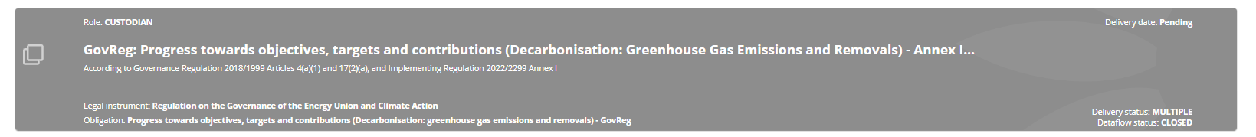
Example
GovReg: Progress towards objectives, targets and contributions (Decarbonisation: Greenhouse Gas Emissions and Removals) - Annex I [2023]
MS : France

Slide 63

Exercise

Slide 64
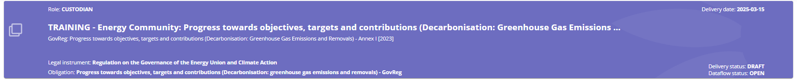
Exercise
Log into Reportnet, access the Annex I and upload the TRAINING template
Review the tables
Note any questions or concerns
If you want, try to add some data e try to validation

Slide 65

Questions?
Answer the following questions as a group:
Are you able to identify the data needed?
Are you able to identify the person or people who could work on this annex?
Do you think you will manage to submit it?
marta.baldi@eea.europa.eu
Notes:
If you have any issues with the platform, questions, or would like to request any form of assistance from us, please do not hesitate to contact us. We will be happy to support you. I am sharing our emails here on this slide. You can reach out to me if you have any questions regarding reporting on climate adaptation, and you can reach out to my colleague Marc if you have any technical issues.

